Slide 1
Heath Freedom Landscape
for Aromatherapists
Anne Gillum JD
State Legislative Director
National Health Freedom Action (Coalition)
September 26-29, 2019
Alliance of International Aromatherapists
Minneapolis, Minnesota

Slide 2
National Health Freedom Action
501c4 nonprofit (sister c3 NHFCoalition)
The Vision: A healthy nation, with empowered people, making informed health care decisions.
The Mission: To promote access to all health care information, services, treatments and products that the people deem beneficial for their own health and survival; to promote legislative reform of the laws impacting the right to access; and to promote the health of the people of this nation.

Slide 3
U.S. Laws and Regulations Of the People, By the People and For the People
The Voice of Freedom
Making and Changing laws
Words Matter
Notes:
We are a Government –

Slide 4
State Activism
harnessing police power
Local Level

Slide 5
2016 Washington State Homeopath Investigation
Practicing Medicine
Practicing Naturopathic Medicine
Notes:
Broad definitions
Good for the profession because gives them great latitude in treating
Describes many tools that they have
Bad for health freedom because presents criminal charges for anyone other than a licensed MD who does anything within that broad definition

Slide 6
Washington Definition Practice of MEDICINE
“…(1) Offers or undertakes to diagnose, cure, advise, or prescribe for any human disease, ailment, injury, infirmity, deformity, pain or other condition, physical or mental, real or imaginary, by any means or instrumentality;…”
Washington RCW 18.71.011

Slide 7
2017 Maine Homeopaths Wishing to Open Healing Center
Practicing Medicine?

Slide 8
Maine Law PRACTICE OF MEDICINE
“…diagnosing, relieving in any degree or curing, or professing or attempting to diagnose, relieve or cure a human disease, ailment, defect or complaint, whether physical or mental, or of physical and mental origin, by attendance or by advice, or by prescribing or furnishing a drug, medicine, appliance, manipulation, method or a therapeutic agent whatsoever or in any other manner unless otherwise provided by statutes of this State. ME Title 32, Chapter 48

Slide 9
Maine Law EXEMPTIONS to Class E Crime
“… Nothing in this chapter may be construed as to affect or prevent the practice of the religious tenets of a church in the ministration to the sick or suffering by mental or spiritual means.”
ME Title 32, Chapter 48

Slide 10
2018 Maine Bill to Add New License
LD 1384 (SP 428)
"An Act Relating to Complementary and Alternative Medicine Licensure“
"Holistic health practitioner" means:
A. Any person who is not a licensed massage therapist, but […];
B. Any person who is not a licensed dietician, but […];
C. Any person who through accredited formal education and training engages in clinical aromatherapy and uses or makes recommendations for the use or consumption of essential oils to support wellness;
Notes:
Oppose LD 1384 – The terrible Holistic Practitioner Licensing bill restrictively regulates all complementary and alternative health care practitioners and would have broad negative implications for consumer choice. LD 1384 would effectively ban the communication of information and recommendations of nutrition, dietary supplements, homeopathic remedies, essential oils, mind-body practices, and many other services and products that are successfully and safely used by practitioners in Maine and are in great demand by Maine consumers. It would impose unnecessary civil violations for all persons practicing their healing arts trades unless they are state licensed as a “holistic health practitioner”, a term the bill creates and broadly defines.

Slide 11
Maine Bill to Add New License, cont.
Licensure required; Exception - Only if licensed to practice any healing art or science and who uses holistic health practices in the course of that practice and within the scope of that license.
Eligibility - to apply for a license to practice holistic health, an applicant must: A. […]
B. Hold or have held licensure or professional certification in any licensed medical or dental profession …or hold or have held certification as an educational or behavioral consultant …;
C. Hold certification in at least 2 complementary health practices described in section 12501, subsection 5-B; and
D. Have met education and experience requirements set by board... must include the following:
(1) Satisfactory evidence of either:
(a) Completion of a doctoral degree from an accredited institution …, completion of a practicum or internship in the field of intended practice and completion of 1,800 hours of supervision …; or
(b) Completion of a master's degree in the last 10 years and completion of at least 24 credits of classroom instruction in any combination of biology, anatomy, chemistry, physiology, psychology or pharmacology or …;

Slide 12
Maine Bill to Add New License, cont.
(2) Documented training in no less than 4 of the 7 recognized mind-body modalities, including manual healing methods, clinical aromatherapy and herbal medicine, alternative systems of medical practice, mind-body interventions, bio-electromagnetic applications and life or health coaching. …;
(3) Documented evidence of completion of no less than 3 credit hours in the ethics of …at an accredited institution of higher learning;
(4) An agreement and supervision plan with a licensed complementary health care provider to provide no less than 1,800 hours of clinical supervision of the applicant; and
(5) Satisfactory evidence of professional liability insurance.

Slide 13
2018 Maine Bill to Add New Exemption
LD 364 (SP 104)
"An Act to Establish the Right to Practice Complementary and Alternative Health Care Act"
Sponsored by Senator David Miramant
Passed into law on June 11, 2019!!!

Slide 14
2019 Maine Law New Exemption
“…A person who provides complementary or alternative health care services in accordance with this subchapter but who is not licensed, certified or registered in this State as a health care professional or practitioner under this Title does not violate any law relating to the licensing of health care professionals under this Title as long as the person complies with the requirements of this subchapter.”
Sec. 1. 32 MRSA c. 113-B, sub-c. 5

Slide 15
Safe Harbor Maine at the Capitol

Slide 16
2011-2019 Wisconsin Wishing to protect herbalists, homeopaths, and traditional naturopaths
Practicing Medicine?

Slide 17
Wisconsin State Law PRACTICE OF MEDICINE
“…(a) To examine into the fact, condition or cause of human health or disease, or to treat, operate, prescribe or advise for the same, by any means or instrumentality.
(b) To apply principles or techniques of medical sciences in the diagnosis or prevention of any of the conditions described in par. (a) and in sub. (2).
(c) To penetrate, pierce or sever the tissues of a human being.
(d) To offer, undertake, attempt or do or hold oneself out in any manner as able to do any of the acts described in this subsection.”
WI Stat. 448.01 (9)

Slide 18
2015-2019 Massachusetts Wishing to protect bodyworkers, herbalists, homeopaths, and more
Practicing Medicine?

Slide 19
Massachusetts Regulation PRACTICE OF MEDICINE
“…The purpose or reasonably foreseeable effect of which is to encourage the reliance of another person upon an individual's knowledge or skill in the maintenance of human health by the prevention, alleviation, or cure of disease, and involving or reasonably thought to involve an assumption of responsibility for the other person's physical or mental well being: diagnosis, treatment, use of instruments or other devices, or the prescribing, administering, dispensing or distributing of drugs for the relief of diseases or adverse physical or mental conditions.”
§ 2.01(4), 243 CMR 2.00

Slide 20
Massachusetts Law Exemptions
“…Domestic administration of family remedies…clairvoyants or persons practicing hypnotism, magnetic healing, mind cure, massage, Christian Science or cosmopathic method of healing, if they do not violate any provisions of section six.”
Mass. Gen. Laws Ch. 112 §7

Slide 21
Massachusetts Bill to Broaden Exemptions
H.3660 / S.665
Representative John Lawn, Jr. / Senator Nick Collins
An Act providing for consumer access to and the right to practice complementary and alternative health care services

Slide 22
HFAMA Leaders at the Capitol

Slide 23
Maryland Law Practice of NATUROPATHIC Medicine
(g) (1) “Naturopathic medicine” means the prevention, diagnosis, and treatment of human health conditions, injury, and disease using only patient education and naturopathic therapies and therapeutic substances recognized by the Council of Naturopathic Medical Education.
(2) “Naturopathic medicine” includes:
(i) Counseling;
(ii) The practice of the mechanical sciences of healing, including mechanotherapy, articular manipulation, corrective and orthopedic gymnastics, hydrotherapy, electrotherapy, and phototherapy; and
(iii) The practice of the material sciences of healing, including nutrition, phytotherapy, treatment by natural substances, and external applications.
§14–5F–01

Slide 24
Maryland Law Felony
(a) Except as otherwise provided in this subtitle, an individual may not practice, attempt to practice, or offer to practice naturopathic medicine in this State without a license.
(b) An individual who violates this section is guilty of a felony and on conviction is subject to:
(1) A fine not exceeding $10,000 or imprisonment not exceeding 5 years or both; and
(2) A civil fine of no more than $50,000 to be levied by the Board.
§14–5F–29
Notes:
Criminal charges

Slide 25
Maryland Law Title Protection
(a) Unless an individual is licensed to practice naturopathic medicine, the individual may not:
(1) Represent to the public by title, by description of services, methods, or procedures, or otherwise, that the individual is licensed by the Board to practice naturopathic medicine;
(2) Use the title “doctor of naturopathic medicine”, “doctor of naturopathy”, “naturopathic doctor”, or “naturopath”; or
(3) Use the initials “N.D.”, “ND”, “NMD”, or “N.M.D.” after the name of the individual.
(b) An individual licensed to practice naturopathic medicine in the State may not use the title “physician”.
§14–5F–30

Slide 26
Kansas Law Healing Arts Not a Natural Right
Purpose. Recognizing that the practice of the healing arts is a privilege granted by legislative authority and is not a natural right of individuals, it is deemed necessary as a matter of policy in the interests of public health, safety and welfare, to provide laws and provisions covering the granting of that privilege and its subsequent use, control and regulation to the end that the public shall be properly protected against unprofessional, improper, unauthorized and unqualified practice of the healing arts and from unprofessional conduct by persons licensed to practice under this act.
Kan. Stat. Ann. § 65-2801 (1957)
Notes:
Broad definitions
Good for the profession because gives them great latitude in treating
Describes many tools that they have

Slide 27
Georgia Law Definition Practice of Medicine
“…the diagnosis or treatment of disease, defects, or injuries of human beings; or the suggestion, recommendation, or prescribing of any form of treatment for the intended palliation, relief, or cure of any physical, mental, or functional ailment or defect of any person”
GA Stat. § 43-34-21

Slide 28
Alabama Law Definition Practice of Medicine
“To diagnose, treat, correct, advise, or prescribe for any human disease, ailment, injury, infirmity, deformity, pain, or other condition, physical or mental, real or imaginary, by any means or instrumentality;”
Section 34-24-50

Slide 29
New Mexico’s Exemption Law
"complementary & alternative health care service" means the broad domain of complementary & alternative healing methods & treatments including: (1) anthroposophy; (2) aromatherapy; (3) ayurveda; (4) culturally traditional healing practices, including practices by a curandera, sobadora, partera, medica & arbolaira, & healing traditions, including plant medicines & foods, prayer, ceremony & song; (5) detoxification practices & therapies; (6) energetic healing; (7) folk practices; (8) Gerson therapy & colostrum therapy; (9) healing practices utilizing food, dietary supplements, nutrients & the physical forces of heat, cold, water, touch & light; (10) healing touch; (11) herbology or herbalism; (12) homeopathy; (13) meditation; (14) mind-body healing practices; (15) naturopathy; (16) nondiagnostic iridology; (17) noninvasive instrumentalities; (18) polarity therapy; & (19) holistic kinesiology & other muscle testing techniques.” 61-35-2

Slide 30
Nevada’s Exemption Law for “Wellness Services”
(a) Anthroposophy. (b) Aromatherapy. (c) Traditional cultural healing practices. (d) Detoxification practices and therapies. (e) Energetic healing. (f) Folk practices. (g) Gerson therapy and colostrum therapy. (h) Healing practices using food, dietary supplements, nutrients and the physical forces of heat, cold, water and light. (i) Herbology and herbalism. (j) Reflexology and Reiki. (k) Mind-body healing practices. (l) Nondiagnostic iridology. (m) Noninvasive instrumentalities. (n) Holistic kinesiology.

Slide 31
Nevada Collaboration with Contract Lobbyist

Slide 32
2019 Safe Harbor Practitioner Exemption States!
Oklahoma *
Idaho *
Minnesota
Rhode Island
California
Louisiana
Arizona
(limited)
New Mexico
Colorado
Nevada
Maine

Slide 33
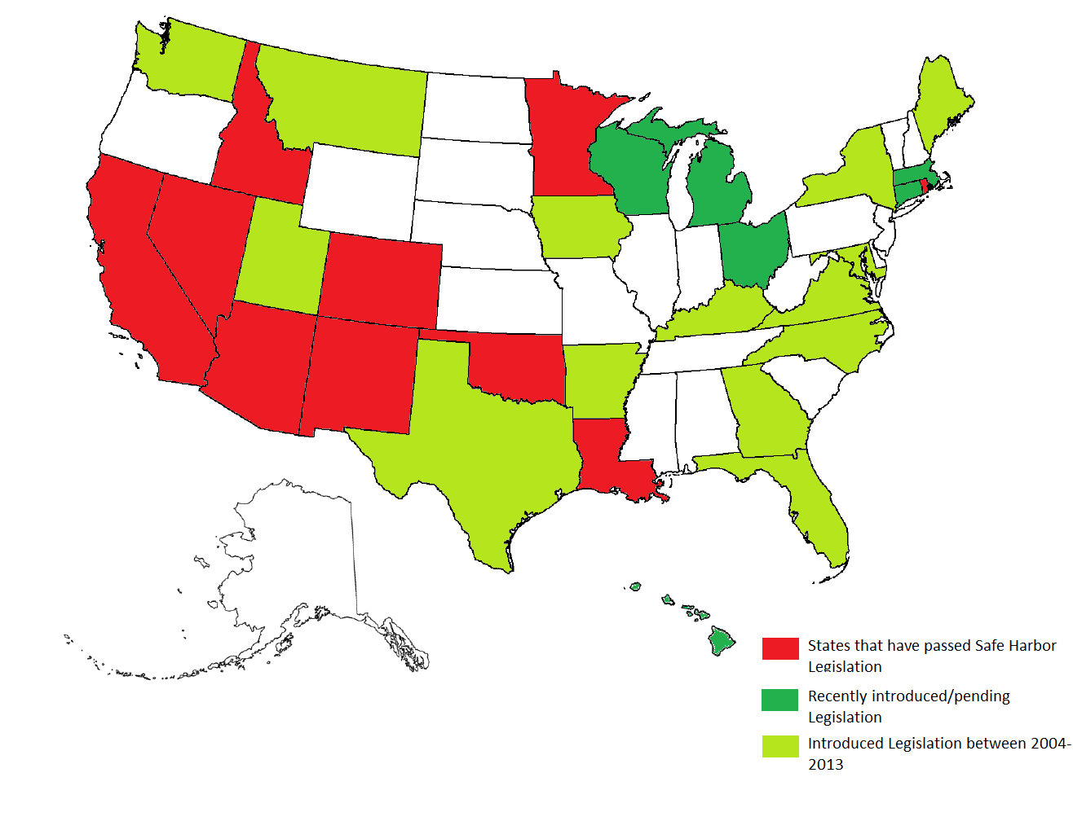
Notes:
Maine should be red! Shades of green mean Exemption bill introduced at some point but didn’t pass yet for any number of reasons related to legislative process, politics, etc.

Slide 34
How to Pass a Bill in Your State
www.nationalhealthfreedomaction.org
NHFA Attorneys to Help Guide
- Conference calls
- Travel and Presentations
- Drafting
- Testimony

Slide 35
State Health Freedom Groups Working on Many Issues
Practitioner Rights
Vaccine Exemption Rights
GMO Labeling
Geo-engineering
Electromagnetic Frequency
Glyphosate (Roundup) Levels
Regenerative Ag Projects

Slide 36
Federal Activism
harnessing regulators
Federal commerce

Slide 37
Federal Issues
Homeopathic Remedies – Draft Guidance
GMO Labeling – Passage of Dark Act
Vaccine Mandates – state by state but really CDC
Dietary Supplements – New Ingredient Guidelines
Geoengineering – who regulates the air
Electromagnetic Frequencies - pervasive

Slide 38
Federal Law Definition of Drug
The term “drug” means
articles recognized in the official United States Pharmacopoeia, official Homeopathic Pharmacopoeia of the United States, or official national Formulary, or any supplement to any of them; and
articles intended for use in the diagnosis, cure, mitigation, treatment or prevention of disease in man or other animals; and
articles (other than food) intended to affect the structure or any function of the body of man or other animals; and
articles intended for use as a component of any article specified in Clauses (A), (B) or (C ) of this paragraph. A food or dietary supplement for which a claim ….”.
21 U.S.C. 321(g)1

Slide 39
Dietary Supplement = Food
“A vitamin; A mineral; An herb or other botanical; An amino acid; A dietary substance for use by man to supplement the diet by increasing the total dietary intake; or A concentrate, metabolite, constituent, extract, or combination of any ingredient mentioned above…”

Slide 40
U.S. Dietary Supplements
* Regulated as Foods and not drugs
* Generally Regarded as Safe (GRAS)
unless proven otherwise

Slide 41
U.S. Dietary Supplements
Marketed Before 1994

Slide 42
U.S. Dietary Supplements
Negative Impact of
New Dietary Ingredient Guidelines

Slide 43
WHO is representing YOU?
We need to be at the table long term if we plan to make a difference and protect health freedom.

Slide 44
We Need Leaders …
Who understands health freedom?
Who wants health freedom?
Who teaches health freedom?
Who lives health freedom?
(and/or your financial support ☺)

Slide 45
BE AN AGENT OF CHANGE
“Laws and customs must be carefully reviewed, revised, and even repealed if necessary, and new laws created, to reflect the development, evolution, and spiritual maturization of a people.”
-Diane Miller

Slide 46
Thank You!
Email: a.gillum@nationalhealthfreedom.org
Cell: (612) 237-6684
www.nationalhealthfreedom.org
www.nationalhealthfreedomaction.org

