Slide 1
Heath Freedom Landscape
For Herbalists
Diane Miller JD
Director Law and Public Policy
National Health Freedom Action
June 9, 2017
Midwest Women’s Herbal Conference
Almond, WI

Slide 2
Law - The Voice of
Freedom…

Slide 3
State Activism
harnessing police power
Local Level

Slide 4
2015-2016 Washington Homeopath Investigation
Practicing Medicine
Practicing Naturopathic Medicine
Notes:
Broad definitions
Good for the profession because gives them great latitude in treating
Describes many tools that they have

Slide 5
Washington State Law PRACTICE OF MEDICINE Defined
“…(1) Offers or undertakes to diagnose, cure, advise, or prescribe for any human disease, ailment, injury, infirmity, deformity, pain or other condition, physical or mental, real or imaginary, by any means or instrumentality;…” Washington RCW 18.71.011
Notes:
Broad definitions
Good for the profession because gives them great latitude in treating
Describes many tools that they have

Slide 6
Maryland State Law Practice of Naturopathic Medicine
§14–5F–01.
(g) (1) “Naturopathic medicine” means the prevention, diagnosis, and treatment of human health conditions, injury, and disease using only patient education and naturopathic therapies and therapeutic substances recognized by the Council of Naturopathic Medical Education.
(2) “Naturopathic medicine” includes:
(i) Counseling;
(ii) The practice of the mechanical sciences of healing, including mechanotherapy, articular manipulation, corrective and orthopedic gymnastics, hydrotherapy, electrotherapy, and phototherapy; and
(iii) The practice of the material sciences of healing, including nutrition, phytotherapy, treatment by natural substances, and external applications.

Slide 7
Maryland State Law Practice of Naturopathic Medicine
§14–5F–29.
(a) Except as otherwise provided in this subtitle, an individual may not practice, attempt to practice, or offer to practice naturopathic medicine in this State without a license.
(b) An individual who violates this section is guilty of a felony and on conviction is subject to:
(1) A fine not exceeding $10,000 or imprisonment not exceeding 5 years or both; and
(2) A civil fine of no more than $50,000 to be levied by the Board.

Slide 8
Maryland State Law Practice of Naturopathic Medicine
§14–5F–30.
(a) Unless an individual is licensed to practice naturopathic medicine, the individual may not:
(1) Represent to the public by title, by description of services, methods, or procedures, or otherwise, that the individual is licensed by the Board to practice naturopathic medicine;
(2) Use the title “doctor of naturopathic medicine”, “doctor of naturopathy”, “naturopathic doctor”, or “naturopath”; or
(3) Use the initials “N.D.”, “ND”, “NMD”, or “N.M.D.” after the name of the individual.
(b) An individual licensed to practice naturopathic medicine in the State may not use the title “physician”.

Slide 9
Kansas Healing Arts Not a Natural Right
65-2801
Chapter 65.--PUBLIC HEALTH
Article 28.--HEALING ARTS
65-2801. Purpose. Recognizing that the practice of the healing arts is a privilege granted by legislative authority and is not a natural right of individuals, it is deemed necessary as a matter of policy in the interests of public health, safety and welfare, to provide laws and provisions covering the granting of that privilege and its subsequent use, control and regulation to the end that the public shall be properly protected against unprofessional, improper, unauthorized and unqualified practice of the healing arts and from unprofessional conduct by persons licensed to practice under this act.
History: L. 1957, ch. 343, § 1; July 1.
Notes:
Broad definitions
Good for the profession because gives them great latitude in treating
Describes many tools that they have

Slide 10
New Mexico 61-35-2 Complementary and Alternative Health Care Services:
B. "complementary and alternative health care service" means the broad domain of complementary and alternative healing methods and treatments including: (1) anthroposophy; (2) aromatherapy; (3) ayurveda; (4) culturally traditional healing practices, including practices by a curandera, sobadora, partera, medica and arbolaira, and healing traditions, including plant medicines and foods, prayer, ceremony and song; (5) detoxification practices and therapies; (6) energetic healing; (7) folk practices; (8) Gerson therapy and colostrum therapy; (9) healing practices utilizing food, dietary supplements, nutrients and the physical forces of heat, cold, water, touch and light; (10) healing touch; (11) herbology or herbalism; (12) homeopathy; (13) meditation; (14) mind-body healing practices; (15) naturopathy; (16) nondiagnostic iridology; (17) noninvasive instrumentalities; (18) polarity therapy; and (19) holistic kinesiology and other muscle testing techniques

Slide 11
2017 Safe Harbor Health Freedom States!
Oklahoma *
Idaho *
Minnesota
Rhode Island
California
Louisiana
Arizona (limited)
New Mexico
Colorado
Nevada!

Slide 12
ME
WA
MT
ND
MN
MI
NH
NY
VT
WI
MA
SD
OR
ID
WY
OH
CT
RI
NE
IA
PA
IL
IN
NJ
MO
DE
CA
NV
WV
MD
DC
UT
CO
KS
AR
KY
VA
AZ
Homeopathy only
NM
OK
TN
NC
LA
MS
AL
GA
SC
TX
FL
AK
HI

Slide 13
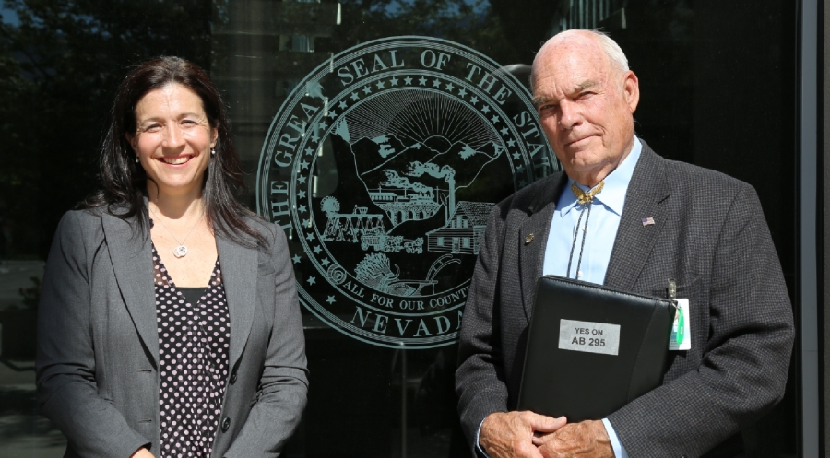

Slide 14
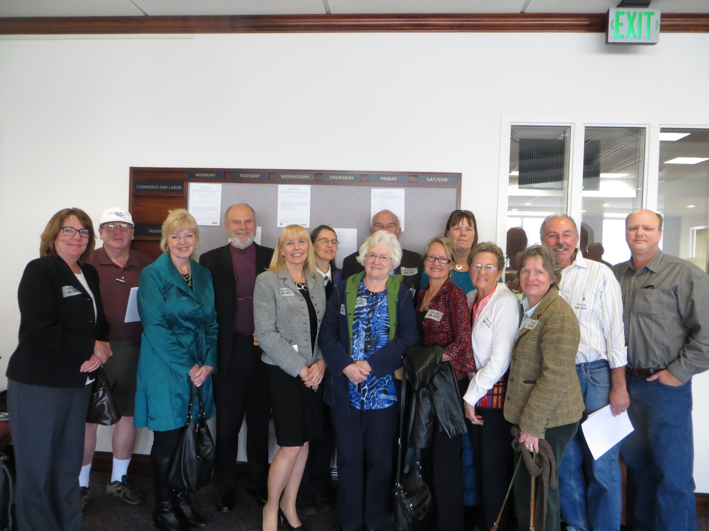

Slide 15
State Groups Working on Many Issues
Practitioner Rights
Vaccine Exemption Rights
GMO Labeling
Geo-engineering
Electromagnetic Frequency
Glyphosates Roundup Levels
Regenerative Projects

Slide 16
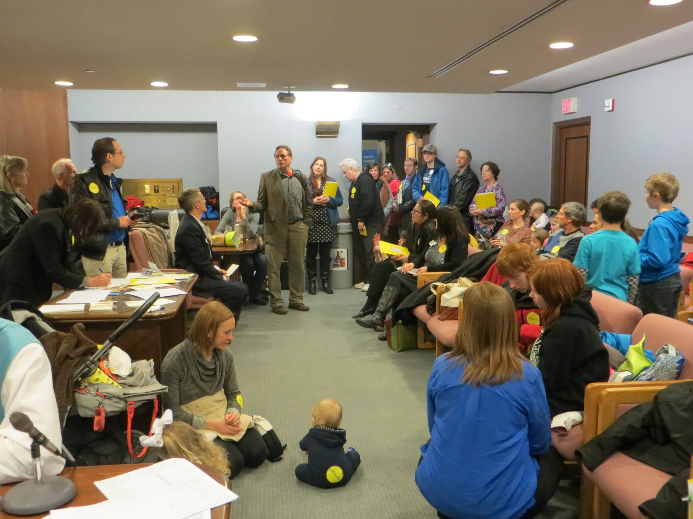

Slide 17
VACCINE MANDATES

Slide 18
Parents Coerced into Getting Vaccines for their Children
The following are the diseases for which immunizations shall be
documented:
(1) Diphtheria.
(2) Haemophilus influenzae type b.
(3) Measles.
(4) Mumps.
(5) Pertussis (whooping cough).
(6) Poliomyelitis.
(7) Rubella.
(8) Tetanus.
(9) Hepatitis B.
(10) Varicella (chickenpox).
(11) Any other disease deemed appropriate by the department,
taking into consideration the recommendations of the Advisory
Committee on Immunization Practices of the United States Department
of Health and Human Services, the American Academy of Pediatrics, and
the American Academy of Family Physicians.

Slide 19
GMO Labeling
The Dark Act: Took away Vermont and all other states rights to label GMOs

Slide 20
Parents Forced to Agree to Chemotherapy for their Children
“…(5) is medically neglected, which includes, but is not limited to, the withholding of medically indicated treatment from a disabled infant with a life-threatening condition. The term "withholding of medically indicated treatment" means the failure to respond to the infant's life-threatening conditions by providing treatment, including appropriate nutrition, hydration, and medication which, in the treating physician's or physicians' reasonable medical judgment, will be most likely to be effective in ameliorating or correcting all conditions, except……”
Minnesota Statute Sec. 260C.007 Subd. 6 (5) 2009

Slide 21
Federal Activism
harnessing regulators
Federal commerce

Slide 22
Federal Issues
GMO Labeling – Passage of Dark Act
Vaccine Mandates – state by state
Dietary Supplements – New Ingredient Guidelines
Geoengineering – who regulates the air
Electromagnetic Frequencies - pervasive

Slide 23
FDA Definition of Drug
The term “drug” means
articles recognized in the official United States Pharmacopoeia, official Homeopathic Pharmacopoeia of the United States, or official national Formulary, or any supplement to any of them; and
(B) articles intended for use in the diagnosis, cure, mitigation, treatment or prevention of disease in man or other animals; and
(C ) articles (other than food) intended to affect the structure or any function of the body of man or other animals; and
(D) articles intended for use as a component of any article specified in Clauses (A), (B) or (C ) of this paragraph. A food or dietary supplement for which a claim ….”.
21 U.S.C. 321(g)1

Slide 24
Dietary Supplement = Food
“A vitamin; A mineral; An herb or other botanical; An amino acid; A dietary substance for use by man to supplement the diet by increasing the total dietary intake; or A concentrate, metabolite, constituent, extract, or combination of any ingredient mentioned above…”

Slide 25
U.S. Dietary Supplements
* Regulated as Foods and not drugs
* Generally Regarded as Safe (GRAS)
unless proven otherwise

Slide 26
U.S. Dietary Supplements
Marketed Before 1994

Slide 27
U.S. Dietary Supplements
Impact of
New Dietary Ingredient Guidelines

Slide 28
WHO is representing YOU?
We need to be at the table long term if we plan to make a difference and protect health freedom.

Slide 29
Need Leaders
Who understands health freedom?
Who wants health freedom?
Who teaches health freedom?
Who lives health freedom?

Slide 30
U.S. Health Freedom Congress

Slide 31
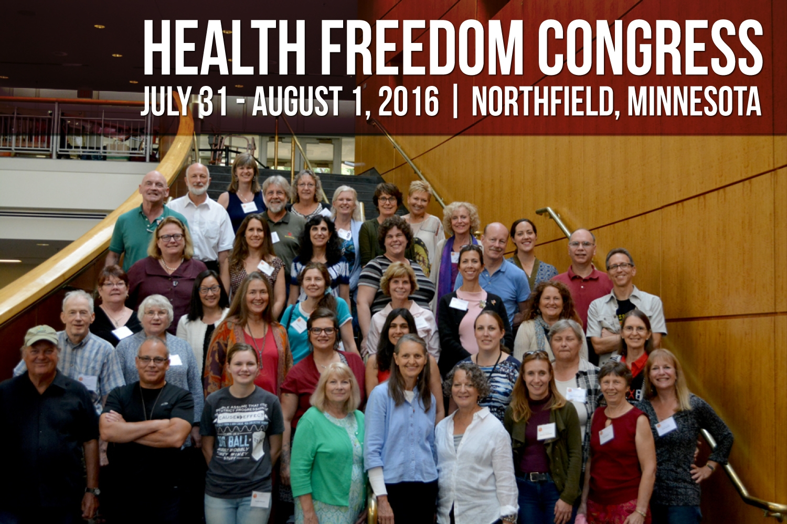

Slide 32
U.S. Health Freedom Congress
United Plant Savers
American Herbalist Guild
Voting Members

Slide 33
Principles of Health Freedom

Slide 34
Principle #1. The fundamental right of self-determination of individuals, to be let alone to survive on their own terms and in their own manner.

Slide 35
Principle #2. The freedom to perceive and to act as one wishes to secure health and survival.
Speak freely
Move about and associate freely
Perceive, believe, meditate, and pray freely
- Practice the healing arts

Slide 36
Principle #3 The freedom to access who and what one needs or prefers for ones health and survival

Slide 37
Principle #4 The responsibility to do no harm.

Slide 38
Principle #5 The responsibility to respectfully tolerate diverse options in health, healing, and survival choices.

Slide 39
Principle #6 The duty of corporations and institutions to be trustworthy entities upholding health freedom rights and liberties of members of the human family, and abiding by health freedom responsibilities.

Slide 40
Principle #7 And in light of the special legal nature of corporate entities and their systemic impact on the human family, the duty to:

Slide 41
#7-1 -honor and preserve the sovereign nature of individuals, the sovereignty of the United States; and avoid any negative impact on the sovereignty of other nation states;

Slide 42
#7-2 -honor and preserve American financial and cultural diversity and multicultural systems, and avoid negative financial or cultural impacts on other nation states;

Slide 43
#7-3 -avoid creating or being monopolies, and avoid the use of large monopolistic ownership of resources to dominate cultures, public policies, regulations and laws;

Slide 44
#7-4 -avoid dominant control of natural resources, avoid the suppression of access to natural resources, and avoid potentially harmful modification or destruction of natural resources; and

Slide 45
#7-5 -avoid promotion of products, protocols, policies, regulations, or laws, that would encourage unlimited dependence on corporations and institutions, or that would discourage, prohibit, or otherwise negatively impact the ability or will of humans and local human communities to survive and prosper without the corporation of institution.

Slide 46
Principle #8
The duty of the government to protect health freedom and to make no law or public policy abridging health freedom or its fundamental principles.

Slide 47
BE AN AGENT OF CHANGE
Laws and customs must be carefully reviewed, revised, and even repealed if necessary, and new laws created, to reflect the development, evolution, and spiritual maturization of a people. -Diane Miller

Slide 48
NATIONAL HEALTH FREEDOM COALITION A 501(c) 3 Educational Nonprofit Organization
NATIONAL HEALTH FREEDOM ACTION
A 501 (c ) 4 Lobbying Organization
Diane Miller JD
Director of Law and Public Policy
PMB 218, 2136 Ford Parkway
St. Paul, MN 55116-1863
www.nationalhealthfreedom.org
E-mail: similars@aol.com
651-470-7367

Slide 49
Freedom to Heal

