Slide 1
Health Freedom Landscape
For Practitioners
Diane Miller JD
Director Law and Public Policy
National Health Freedom Action
September7, 2019
NSP Convention
Las Vegas, NV

Slide 2
Sunshine Health Freedom Foundation’s “VISION”
“We are blazing a trail for generations to come that will allow our children to have health freedom based on what they, not the government, believe are the best choices.”

Slide 3
Law - The Voice of
Freedom…

Slide 4
Practicing – State Law
Are you helping someone with a health problem?
Notes:
Broad definitions
Good for the profession because gives them great latitude in treating
Describes many tools that they have

Slide 5
Practice – State Law v. Selling – Federal Law
Are you helping someone with a health problem?
Are you selling and staying within the what it says on the label?
Notes:
Broad definitions
Good for the profession because gives them great latitude in treating
Describes many tools that they have

Slide 6
State Activism
Local Level

Slide 7
Sunshine Health Freedom Foundation’s “STRATEGY”
FOCUS
passing one state at a time!

Slide 8
Washington State Homeopath Investigation
Practicing Medicine
Practicing Naturopathic Medicine
Notes:
Broad definitions
Good for the profession because gives them great latitude in treating
Describes many tools that they have

Slide 9
Washington State Law PRACTICE OF MEDICINE Defined
“…(1) Offers or undertakes to diagnose, cure, advise, or prescribe for any human disease, ailment, injury, infirmity, deformity, pain or other condition, physical or mental, real or imaginary, by any means or instrumentality;…” Washington RCW 18.71.011
Notes:
Broad definitions
Good for the profession because gives them great latitude in treating
Describes many tools that they have

Slide 10
Maine Homeopath’s Wishing to set up healing center
Practicing Medicine?
Notes:
Broad definitions
Good for the profession because gives them great latitude in treating
Describes many tools that they have

Slide 11
Maine State Law PRACTICE OF MEDICINE
“…diagnosing, relieving in any degree or curing, or professing or attempting to diagnose, relieve or cure a human disease, ailment, defect or complaint, whether physical or mental, or of physical and mental origin, by attendance or by advice, or by prescribing or furnishing a drug, medicine, appliance, manipulation, method or a therapeutic agent whatsoever or in any other manner unless otherwise provided by statutes of this State. ME Title 32, Chapter 48
Notes:
Broad definitions
Good for the profession because gives them great latitude in treating
Describes many tools that they have

Slide 12
Maine Exemptions to Class E Crime
“… Nothing in this chapter may be construed as to affect or prevent the practice of the religious tenets of a church in the ministration to the sick or suffering by mental or spiritual means.
ME Title 32, Chapter 48
Notes:
Broad definitions
Good for the profession because gives them great latitude in treating
Describes many tools that they have

Slide 13
Maine New Law to Get Exemption
"An Act to Establish the Right to Practice Complementary and Alternative Health Care Act"
Sponsored by
Senator David Miramant
ME Title 32, Chapter 48
Notes:
Broad definitions
Good for the profession because gives them great latitude in treating
Describes many tools that they have

Slide 14
Maine New Exemption
“…A person who provides complementary or alternative health care services in accordance with this subchapter but who is not licensed, certified or registered in this State as a health care professional or practitioner under this Title does not violate any law relating to the licensing of health care professionals under this Title as long as the person complies with the requirements of this subchapter.”
ME Title 32, Chapter 48
Notes:
Broad definitions
Good for the profession because gives them great latitude in treating
Describes many tools that they have

Slide 15
Wisconsin Wishing to protect herbalists, homeopaths, and traditional naturopaths
Practicing Medicine?
Notes:
Broad definitions
Good for the profession because gives them great latitude in treating
Describes many tools that they have

Slide 16
Wisconsin State Law PRACTICE OF MEDICINE
“…(a) To examine into the fact, condition or cause of human health or disease, or to treat, operate, prescribe or advise for the same, by any means or instrumentality.
(b) To apply principles or techniques of medical sciences in the diagnosis or prevention of any of the conditions described in par. (a) and in sub. (2).
(c) To penetrate, pierce or sever the tissues of a human being.
(d) To offer, undertake, attempt or do or hold oneself out in any manner as able to do any of the acts described in this subsection.”
WI Stat. 448.01 (9)
Notes:
Broad definitions
Good for the profession because gives them great latitude in treating
Describes many tools that they have

Slide 17
Massachusetts Wishing to protect bodyworkers, herbalists, homeopaths, and more
Practicing Medicine?
Notes:
Broad definitions
Good for the profession because gives them great latitude in treating
Describes many tools that they have

Slide 18
Massachusetts State Law PRACTICE OF MEDICINE
“…The purpose or reasonably foreseeable effect of which is to encourage the reliance of another person upon an individual's knowledge or skill in the maintenance of human health by the prevention, alleviation, or cure of disease, and involving or reasonably thought to involve an assumption of responsibility for the other person's physical or mental well being: diagnosis, treatment, use of instruments or other devices, or the prescribing, administering, dispensing or distributing of drugs for the relief of diseases or adverse physical or mental conditions.”
CMR 243
Notes:
Broad definitions
Good for the profession because gives them great latitude in treating
Describes many tools that they have

Slide 19
Massachusetts Exemptions
“…Domestic administration of family remedies…”
“…clairvoyants or persons practicing hypnotism, magnetic healing, mind cure, massage, Christian Science or cosmopathic method of healing, if they do not violate any provisions of section six.”
Notes:
Broad definitions
Good for the profession because gives them great latitude in treating
Describes many tools that they have

Slide 20
Massachusetts Bill to Get Broader Exemptions
H.3660
Representative John Lawn, Jr.
An Act providing for consumer access to and the right to practice complementary and alternative health care services
S.665
Senator Nick Collins
An Act providing for consumer access to and the right to practice complementary and alternative health care services
Notes:
Broad definitions
Good for the profession because gives them great latitude in treating
Describes many tools that they have

Slide 21
Maryland State Law Practice of Naturopathic Medicine
(g) (1) “Naturopathic medicine” means the prevention, diagnosis, and treatment of human health conditions, injury, and disease using only patient education and naturopathic therapies and therapeutic substances recognized by the Council of Naturopathic Medical Education.
(2) “Naturopathic medicine” includes:
(i) Counseling;
(ii) The practice of the mechanical sciences of healing, including mechanotherapy, articular manipulation, corrective and orthopedic gymnastics, hydrotherapy, electrotherapy, and phototherapy; and
(iii) The practice of the material sciences of healing, including nutrition, phytotherapy, treatment by natural substances, and external applications.
§14–5F–01.

Slide 22
Maryland State Law Felony
(a) Except as otherwise provided in this subtitle, an individual may not practice, attempt to practice, or offer to practice naturopathic medicine in this State without a license.
(b) An individual who violates this section is guilty of a felony and on conviction is subject to:
(1) A fine not exceeding $10,000 or imprisonment not exceeding 5 years or both; and
(2) A civil fine of no more than $50,000 to be levied by the Board.
§14–5F–29.

Slide 23
Kansas Healing Arts Not a Natural Right
Purpose. Recognizing that the practice of the healing arts is a privilege granted by legislative authority and is not a natural right of individuals, it is deemed necessary as a matter of policy in the interests of public health, safety and welfare, to provide laws and provisions covering the granting of that privilege and its subsequent use, control and regulation to the end that the public shall be properly protected against unprofessional, improper, unauthorized and unqualified practice of the healing arts and from unprofessional conduct by persons licensed to practice under this act.
6KS 65-2801 Chapter 65.Article 28
Notes:
Broad definitions
Good for the profession because gives them great latitude in treating
Describes many tools that they have

Slide 24
2019 Safe Harbor Health Freedom States!
Oklahoma *
Idaho *
Minnesota
Rhode Island
California
Louisiana
Arizona (limited)
New Mexico
Colorado
Nevada
Maine!

Slide 25
New Mexico 61-35-2 Complementary and Alternative Health Care Services:
B. "complementary and alternative health care service" means the broad domain of complementary and alternative healing methods and treatments including: (1) anthroposophy; (2) aromatherapy; (3) ayurveda; (4) culturally traditional healing practices, including practices by a curandera, sobadora, partera, medica and arbolaira, and healing traditions, including plant medicines and foods, prayer, ceremony and song; (5) detoxification practices and therapies; (6) energetic healing; (7) folk practices; (8) Gerson therapy and colostrum therapy; (9) healing practices utilizing food, dietary supplements, nutrients and the physical forces of heat, cold, water, touch and light; (10) healing touch; (11) herbology or herbalism; (12) homeopathy; (13) meditation; (14) mind-body healing practices; (15) naturopathy; (16) nondiagnostic iridology; (17) noninvasive instrumentalities; (18) polarity therapy; and (19) holistic kinesiology and other muscle testing techniques

Slide 26
Nevada Wellness Services
(a) Anthroposophy. (b) Aromatherapy. (c) Traditional cultural healing practices. (d) Detoxification practices and therapies. (e) Energetic healing. (f) Folk practices. (g) Gerson therapy and colostrum therapy. (h) Healing practices using food, dietary supplements, nutrients and the physical forces of heat, cold, water and light. (i) Herbology and herbalism. (j) Reflexology and Reiki. (k) Mind-body healing practices. (l) Nondiagnostic iridology. (m) Noninvasive instrumentalities. (n) Holistic kinesiology.

Slide 27
How to Pass a Bill in Your State
www.nationalhealthfreedomaction.org
NHFA Attorneys to Help Guide
- Conference calls
- Travel and Presentations
- Drafting
- Testimony

Slide 28
ME
WA
MT
ND
MN
MI
NH
NY
VT
WI
MA
SD
OR
ID
WY
OH
CT
RI
NE
IA
PA
IL
IN
NJ
MO
DE
CA
NV
WV
MD
DC
UT
CO
KS
AR
KY
VA
AZ
Homeopathy only
NM
OK
TN
NC
LA
MS
AL
GA
SC
TX
FL
AK
HI

Slide 29
ME
WA
MT
ND
MN
MI
NH
NY
VT
WI
MA
SD
OR
ID
WY
OH
CT
RI
NE
IA
PA
IL
IN
NJ
DE
MO
WV
MD
CA
NV
DC
UT
CO
KS
AR
KY
VA
AZ
Homeopathy only
NM
OK
TN
NC
LA
MS
AL
GA
SC
TX
FL
AK
HI

Slide 30
Safe Harbor Maine at the Capitol

Slide 31
Massachusetts Leaders at the Capitol

Slide 32
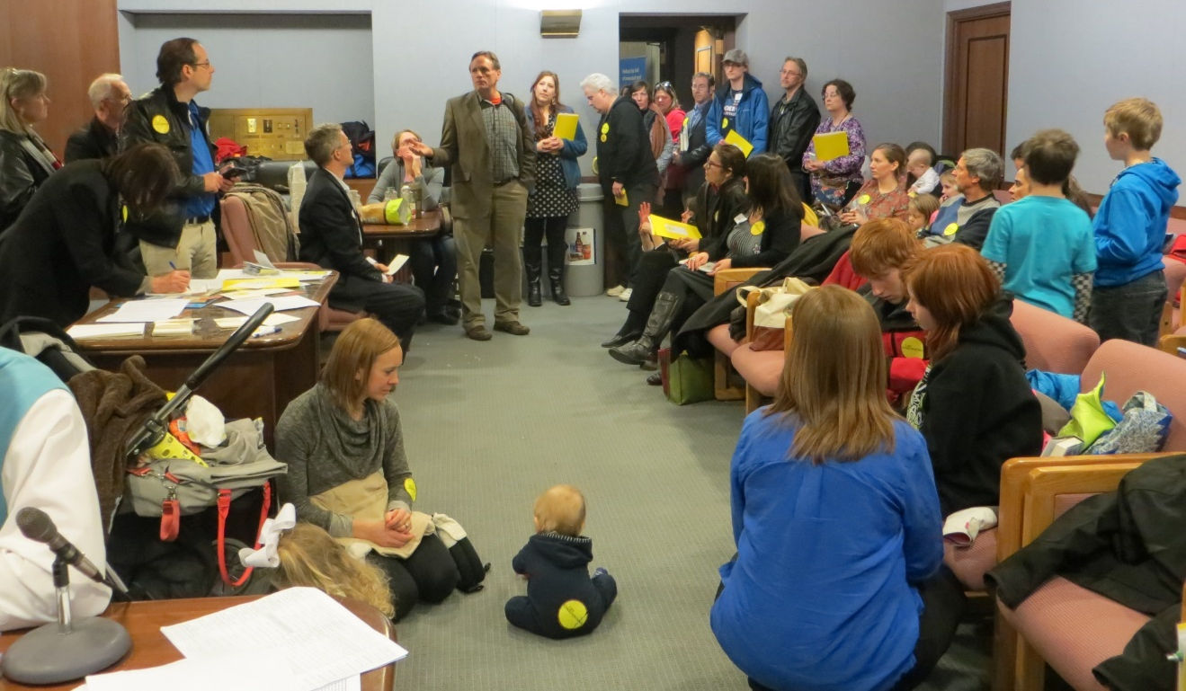
Minnesota Lobby Day at the Capitol

Slide 33
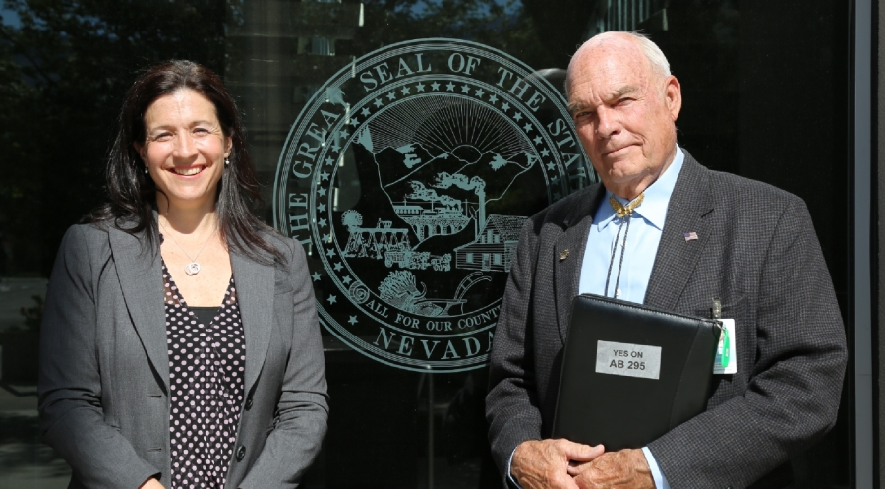
Nevada’s Collaboration with Lobbyist

Slide 34
State Health Freedom Groups Working on Many Issues
Practitioner Rights
Vaccine Exemption Rights
GMO Labeling
Geo-engineering
Electromagnetic Frequency
Glyphosates Roundup Levels
Regenerative Projects

Slide 35
Federal Activism
Federal commerce

Slide 36
Federal Issues
Homeopathic Remedies – Draft Guidance
GMO Labeling – Passage of Dark Act
Vaccine Mandates – state by state
Dietary Supplements – New Ingredient Guidelines
Geoengineering – who regulates the climate
Electromagnetic Frequencies - pervasive

Slide 37
FDA Definition of Drug
The term “drug” means
articles recognized in the official United States Pharmacopoeia, official Homeopathic Pharmacopoeia of the United States, or official national Formulary, or any supplement to any of them; and
(B) articles intended for use in the diagnosis, cure, mitigation, treatment or prevention of disease in man or other animals; and
(C ) articles (other than food) intended to affect the structure or any function of the body of man or other animals; and
(D) articles intended for use as a component of any article specified in Clauses (A), (B) or (C ) of this paragraph. A food or dietary supplement for which a claim ….”.
21 U.S.C. 321(g)1

Slide 38
U.S. Dietary Supplements
(C ) articles (other than food) intended to affect the structure or any function of the body of man or other animals;

Slide 39
Herbs are Regulated as Food
“A vitamin; A mineral; An herb or other botanical; An amino acid; A dietary substance for use by man to supplement the diet by increasing the total dietary intake; or A concentrate, metabolite, constituent, extract, or combination of any ingredient mentioned above…”

Slide 40
Dietary Supplement = Food
“A vitamin; A mineral; An herb or other botanical; An amino acid; A dietary substance for use by man to supplement the diet by increasing the total dietary intake; or A concentrate, metabolite, constituent, extract, or combination of any ingredient mentioned above…”

Slide 41
U.S. Dietary Supplements
* Regulated as Foods and not drugs
* Generally Regarded as Safe (GRAS)
unless proven otherwise

Slide 42
WHO is representing YOU?
We need to be at the table long term if we plan to make a difference and protect health freedom.

Slide 43
Sunshine Health Freedom Foundation WE NEED YOU ON THE TEAM
* SHFF State Coordinators
* SHFF State Volunteers
* Lobbyists and Consultants on the Ground in States
* SHFF Donors
National Health Freedom Action staff helping:
Diane Miller JD, and Anne Gillum JD

Slide 44
Sunshine Health Freedom Foundation Action Steps
Sign Up with SHFF to volunteer in your state
Donate to the SHFF - NSP Fund
We can do this all together!

Slide 45
www.nationalhealthfreedomaction.org
NATIONAL HEALTH FREEDOM ACTION
A 501 (c ) 4 Lobbying Organization
Diane Miller JD
Director of Law and Public Policy
PMB 218, 2136 Ford Parkway
St. Paul, MN 55116-1863
E-mail: similars@aol.com
651-470-7367

Slide 46
Freedom to Heal

Slide 47
U.S. Health Freedom Congress
Voting Members Include:
United Plant Savers
American Herbalist Guild

Slide 48
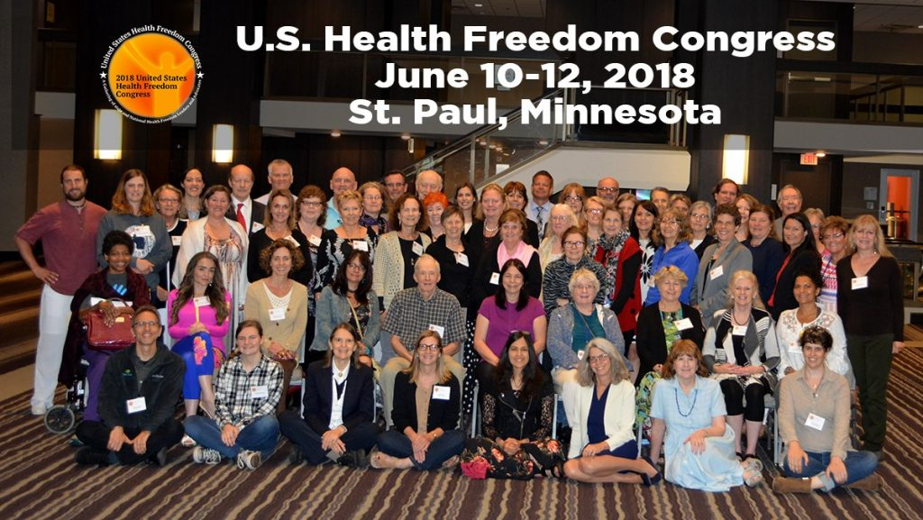

Slide 49
Principles of Health Freedom

Slide 50
Principle #1. The fundamental right of self-determination of individuals, to be let alone to survive on their own terms and in their own manner.

Slide 51
Principle #2. The freedom to perceive and to act as one wishes to secure health and survival.
Speak freely
Move about and associate freely
Perceive, believe, meditate, and pray freely
- Practice the healing arts

Slide 52
Principle #3 The freedom to access who and what one needs or prefers for ones health and survival

Slide 53
Principle #4 The responsibility to do no harm.

Slide 54
Principle #5 The responsibility to respectfully tolerate diverse options in health, healing, and survival choices.

Slide 55
Principle #6 The duty of corporations and institutions to be trustworthy entities upholding health freedom rights and liberties of members of the human family, and abiding by health freedom responsibilities.

Slide 56
Principle #7 And in light of the special legal nature of corporate entities and their systemic impact on the human family, the duty to:

Slide 57
#7-1 -honor and preserve the sovereign nature of individuals, the sovereignty of the United States; and avoid any negative impact on the sovereignty of other nation states;

Slide 58
#7-2 -honor and preserve American financial and cultural diversity and multicultural systems, and avoid negative financial or cultural impacts on other nation states;

Slide 59
#7-3 -avoid creating or being monopolies, and avoid the use of large monopolistic ownership of resources to dominate cultures, public policies, regulations and laws;

Slide 60
#7-4 -avoid dominant control of natural resources, avoid the suppression of access to natural resources, and avoid potentially harmful modification or destruction of natural resources; and

Slide 61
#7-5 -avoid promotion of products, protocols, policies, regulations, or laws, that would encourage unlimited dependence on corporations and institutions, or that would discourage, prohibit, or otherwise negatively impact the ability or will of humans and local human communities to survive and prosper without the corporation of institution.

Slide 62
Principle #8
The duty of the government to protect health freedom and to make no law or public policy abridging health freedom or its fundamental principles.

Slide 63
BE AN AGENT OF CHANGE
Laws and customs must be carefully reviewed, revised, and even repealed if necessary, and new laws created, to reflect the development, evolution, and spiritual maturization of a people. -Diane Miller

